Slide 1
ZEROING IN: THE QUEST FOR INFINITE ENERGY
By Scientists

Slide 2
FORMULATING OUR QUESTION…

Slide 3
COUNTER HYPOTHESIS
Sam and Anna endorse the possibility of infinite energy.

Slide 4
PREDICTION

Slide 6
PROCEDURE

Slide 7
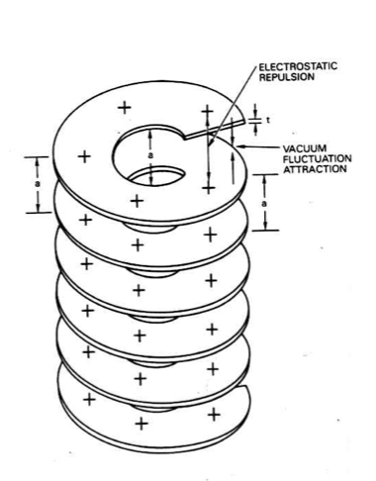

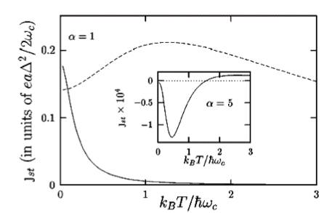
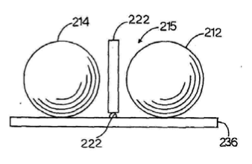

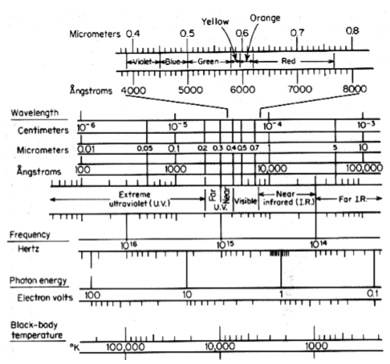
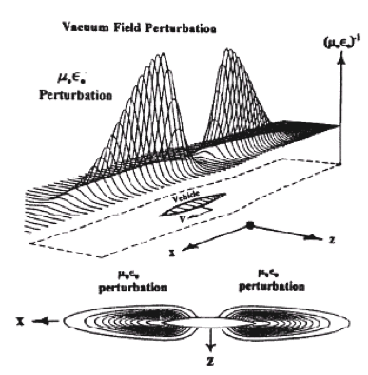
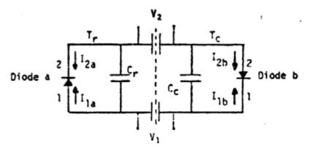

Slide 8
THE TEST: OUR GAY SCIENCE

Slide 9
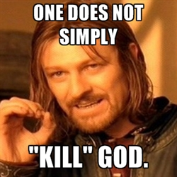
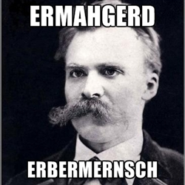

Slide 10
ANALYSIS

Slide 11
